Slide 1

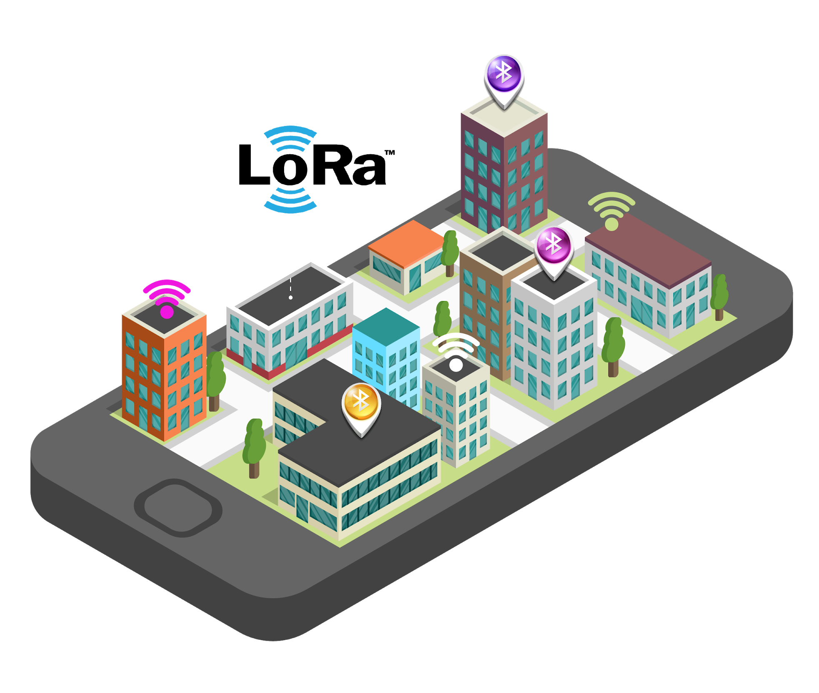
Context Aware IoT System
Context Aware IoT System
Damaris Mendes Ferreira
Dorian Moulinié
Juan Yu
Julien Chouvet
Damaris Mendes Ferreira
Dorian Moulinié
Juan Yu
Julien Chouvet

Slide 2

Project
Context
New Services
SMART CAMPUS
More Enjoyable
More Efficient
‹#›
Notes:
New Services : menu of the restaurant
More Efficient : download the presentation of the course automatically
More Enjoyable : order lunch to the cafet
M

Slide 3


Problem Statement
How to locate users and offer them services depending on their location ?
Indoor Localisation
Data privacy
‹#›
Notes:
Data Privecy = don’t need private info just an identifier of your phone (@MAC)

Slide 4
Contents
Contents
1 Resources
2 Architecture
3 Implementation
4 Results
5 Team work
6 Future works

Slide 5
Resources & Architecture

Slide 6


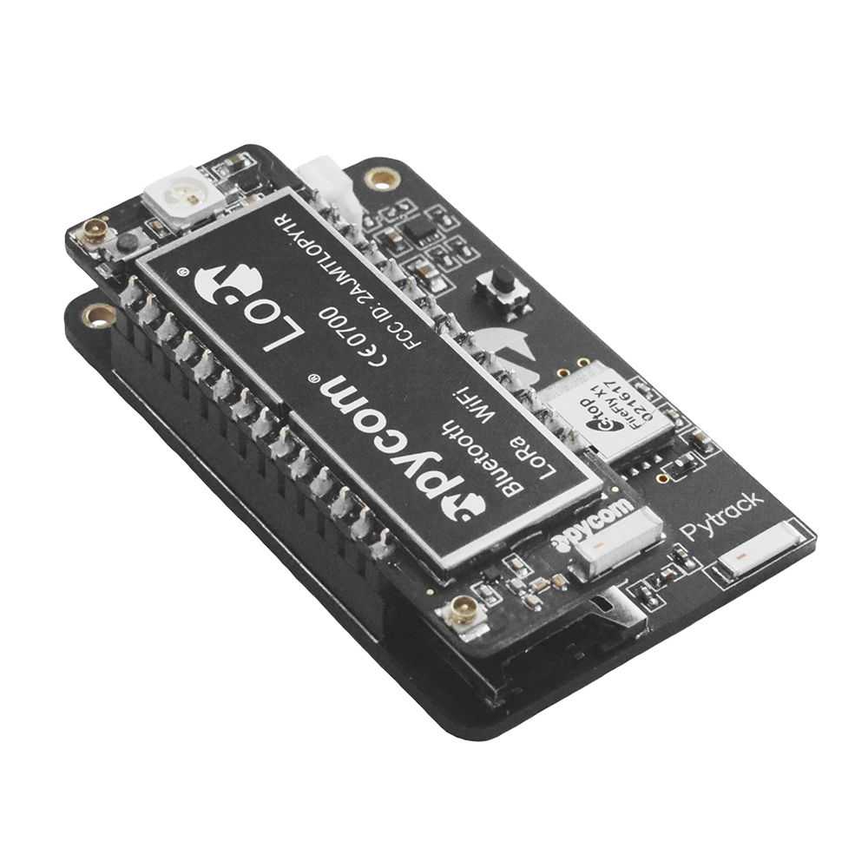
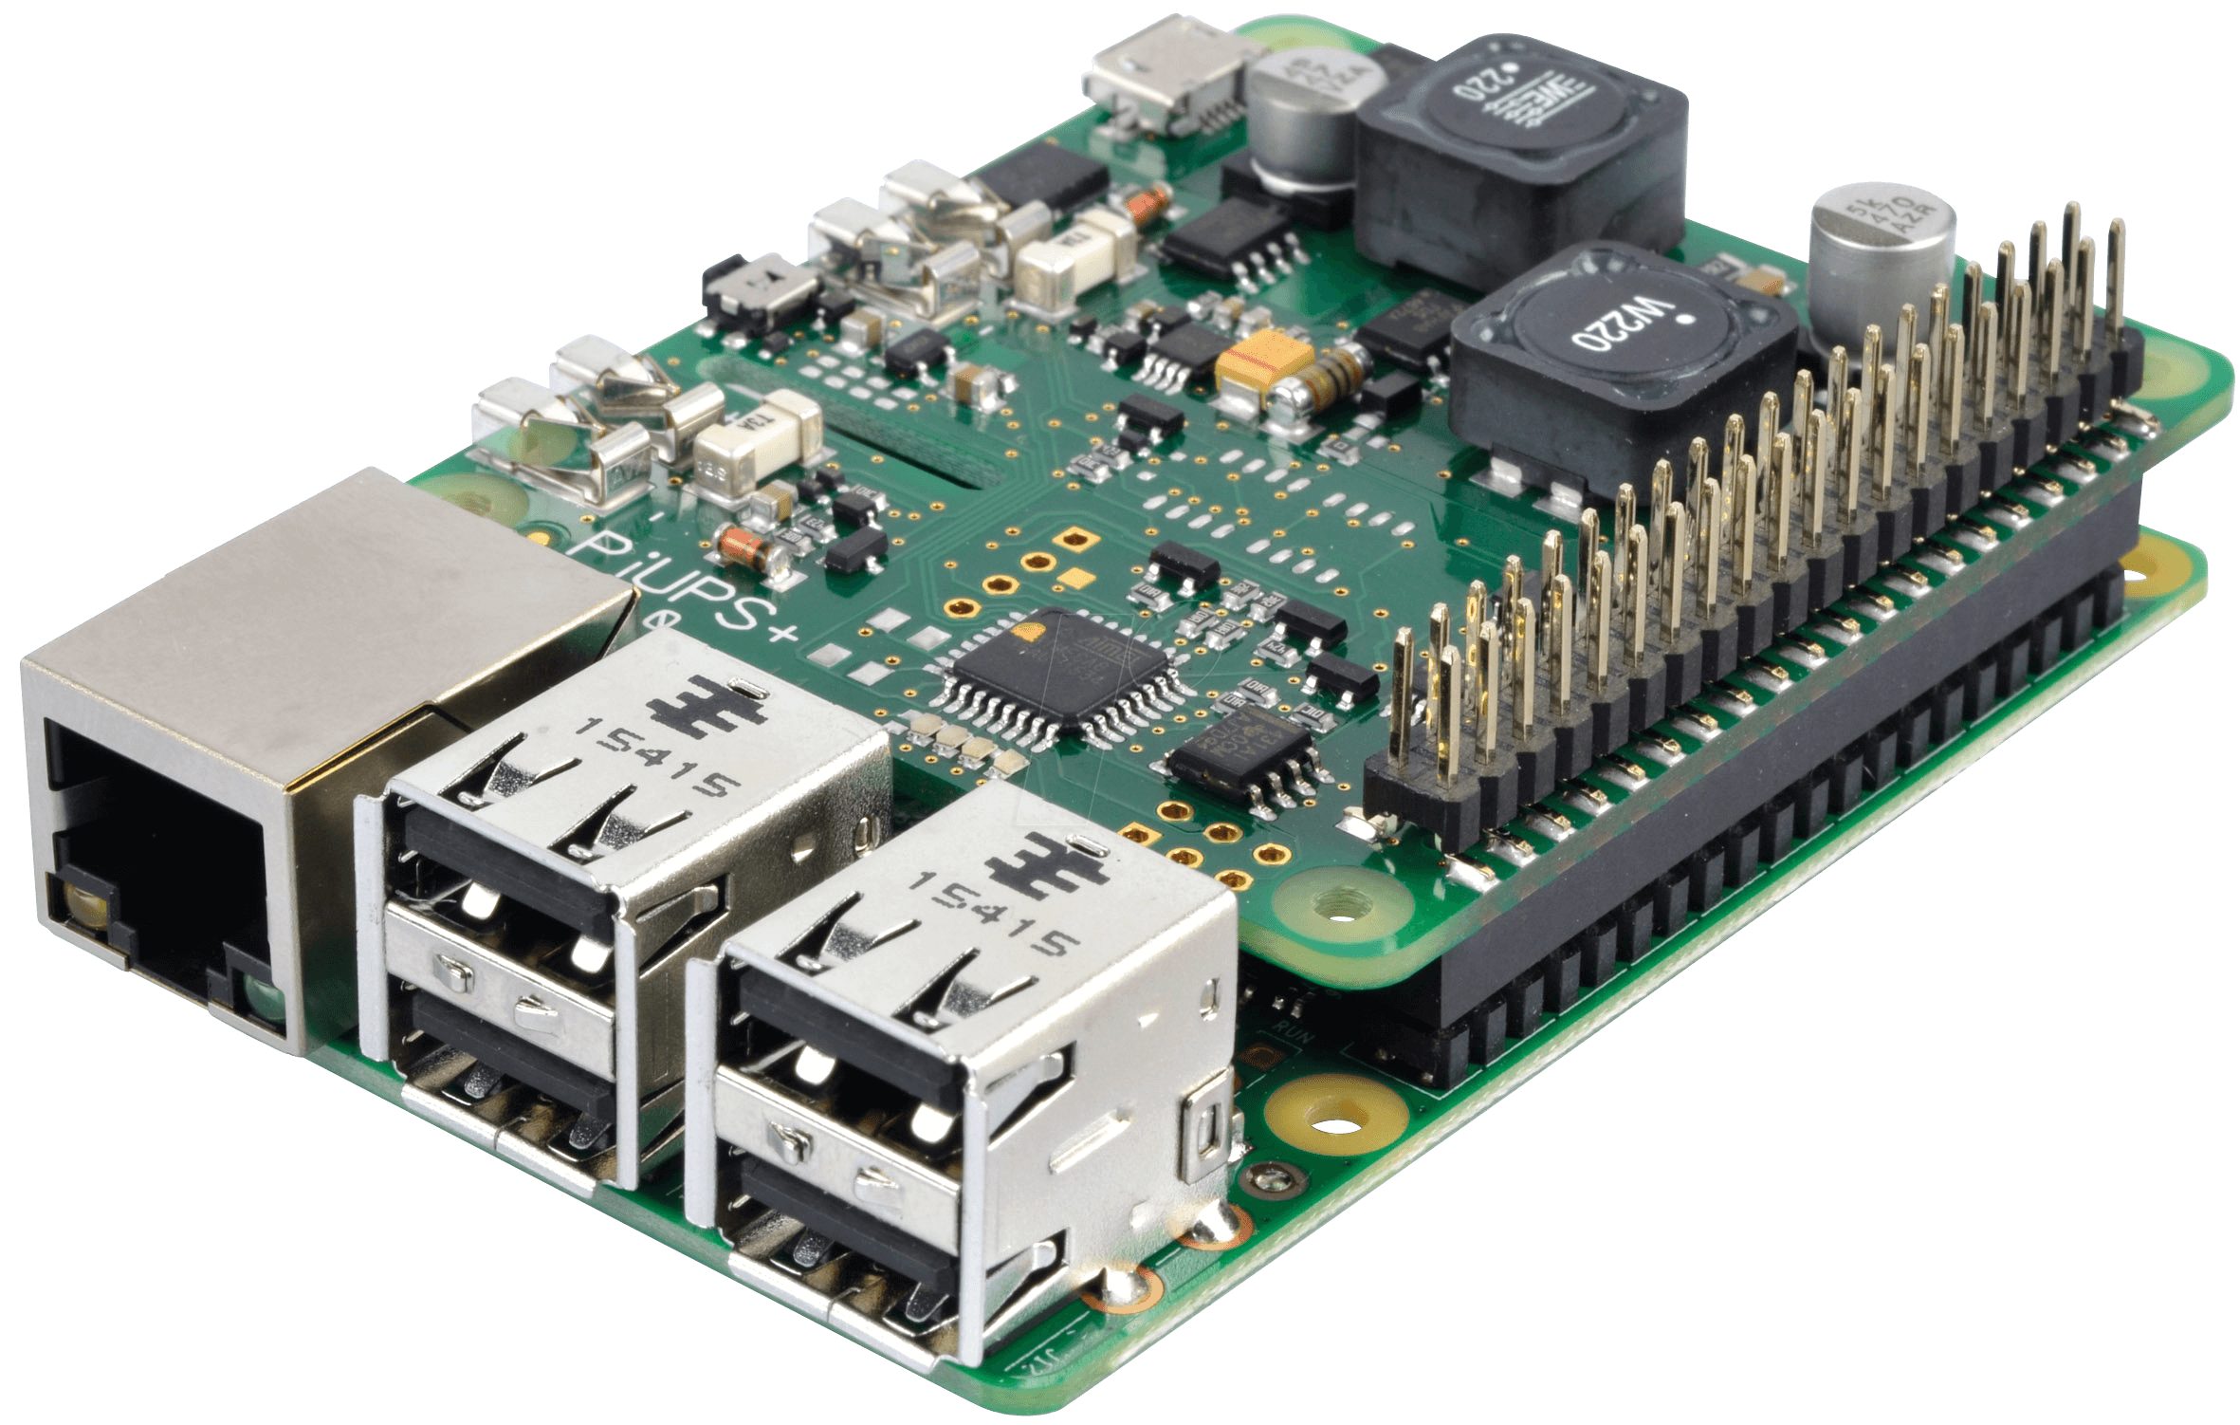
Resources
Existing Environment
Users = Smartphones
Networks = BL & Wifi
Smart Components
Server = Raspberry Pi
Sensors = LoPy + PyTrack
Smart Campus
‹#›
Notes:
We use resources from our existing environment, that is to say, smartphones and Networks, (BL and Wifi but we chose to only focus on Wifi) because we tested our solution in the gei and there is a lot of wifi access point, i think, there is more than 20 access point at this moment in this room.
Our solution is composed of adding smart components which are a Server that we hosted on a Raspberry Pi and Sensors to detect networks.
We only need to deploy the smart components layer, that makes our solution adaptable and scalable for many environment.

Slide 7
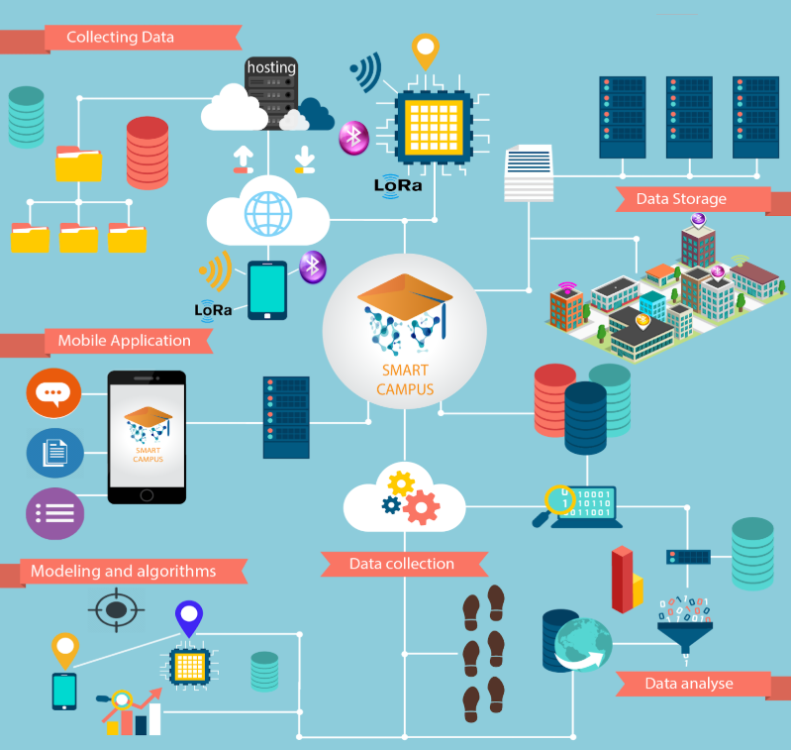
Architecture
‹#›
Notes:
This is an overview of our architecture, we have sensors that collect network information then we compute a footprint that we will present just after then we store this footprint with its localisation in our server. A smartphone will also collect its networks information, after some data analysis and ALGORITHMS that we developed, we will compute a localisation for a user through a mobile application to give them services.

Slide 8
Footprints

Slide 9



Footprints
Smartphone
Hardware
BSSID | RSSI (dB)
b0:6e:bf:d8:97:fc | -42
5c:8a:38:df:6c:a3 | -64
36:a3:95:88:18:32 | -51
... | ...
Static
Dynamic
‹#›
Notes:
Our loc syst is based on what called “footprints”
In a given time, at a given place, a user has a certain footprint. Then, based on this footprint and on a map of footprint previously made we are able to localise the user.
2 different types of footprints…

Slide 10
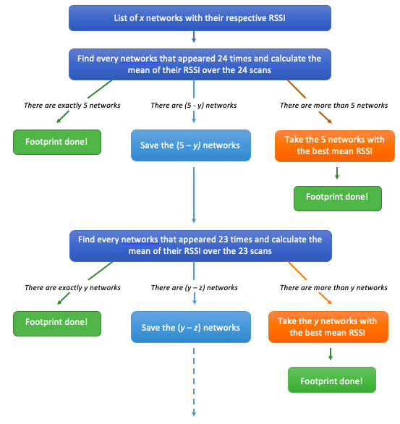
BSSID (= @MAC of the WiFi access point) | RSSI (dB) (= Received Signal Strength Indication)
b0:6e:bf:d8:97:fc | -42
5c:8a:38:df:6c:a3 | -64
36:a3:95:88:18:32 | -51
... | ...
‹#›
Notes:
Why 5 networks => algo by hand + enough representative of a room to make the difference between 2 rooms
See at the end that we can extend this limit and the impact it has on the results

Slide 11
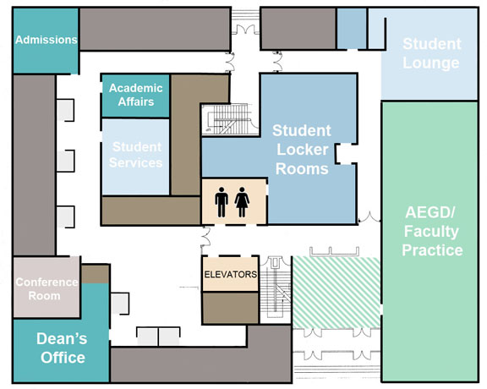
Footprints
BSSID | RSSI (dB)
b0:6e:bf:d8:97:fc | -42
5c:8a:38:df:6c:a3 | -51
36:a3:95:88:18:32 | -59
34:8f:27:0a:7d:b8 | -64
ac:3b:77:fb:2f:5e | -67
BSSID | RSSI (dB)
c7:6e:bf:d8:97:fc | -40
d8:8a:38:df:6c:a3 | -55
9f:a3:95:88:18:32 | -61
94:8f:27:0a:7d:b8 | -64
fd:3b:77:fb:2f:5e | -80
BSSID | RSSI (dB)
hf:6e:bf:d8:97:fc | -42
8a:8a:38:df:6c:a3 | -57
7e:a3:95:88:18:32 | -59
87:8f:27:0a:7d:b8 | -62
ca:3b:77:fb:2f:5e | -69
BSSID | RSSI (dB)
22:6e:bf:d8:97:fc | -51
7d:8a:38:df:6c:a3 | -55
d9:a3:95:88:18:32 | -59
cb:8f:27:0a:7d:b8 | -67
55:3b:77:fb:2f:5e | -70
‹#›

Slide 12
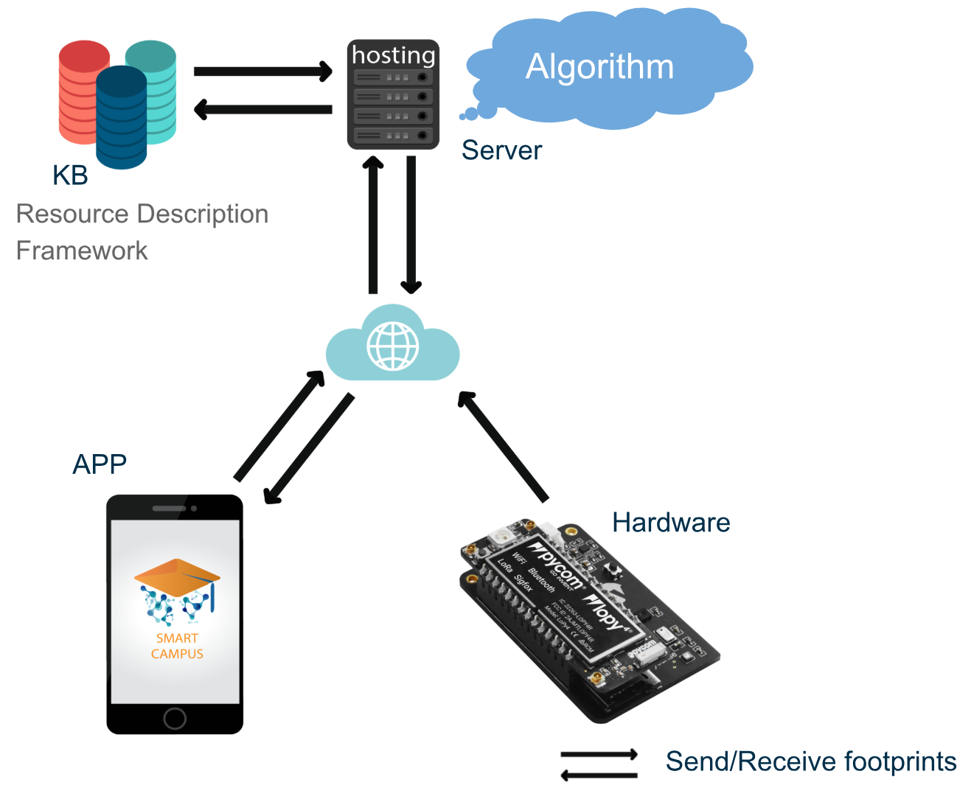
Hardware
Notes:
ATTENTION : Animation !

Slide 13
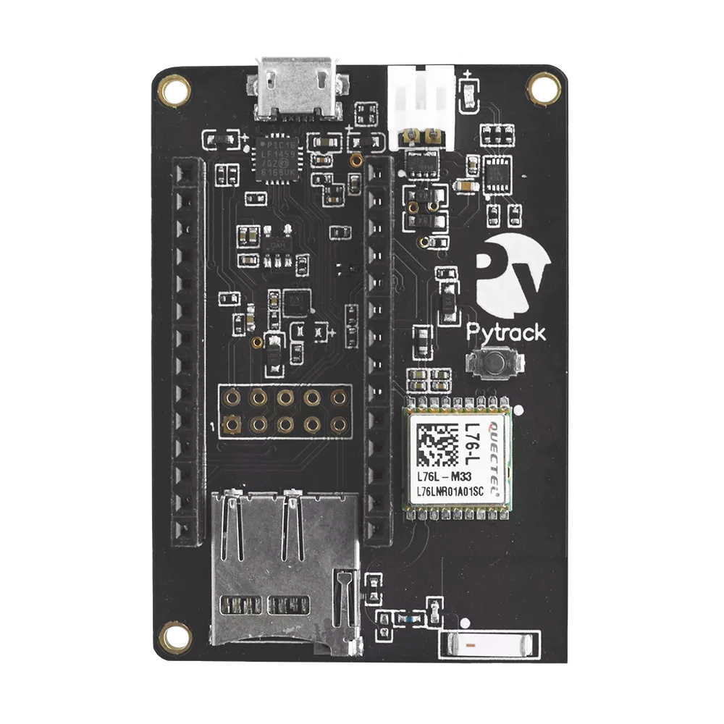
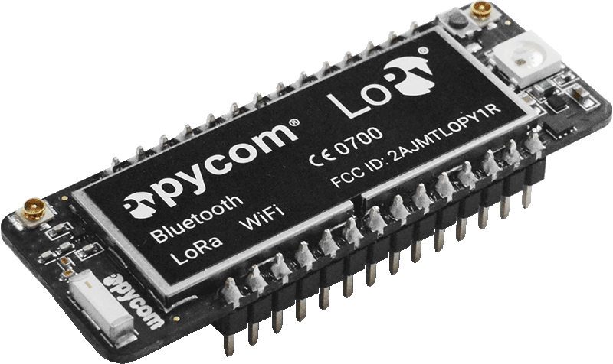


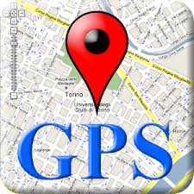


Hardware
Lopy 4
Pytrack
Mapping of the rooms:
Static mapping
Dynamic mapping
‹#›
Notes:
Hardware provides BL+Wifi and GPS and its goal is to determine which one of these 2 technologie (GPS or WiFi+BL) is the best for indoor localisation

Slide 14
Application
Notes:
ATTENTION : Animation !

Slide 15
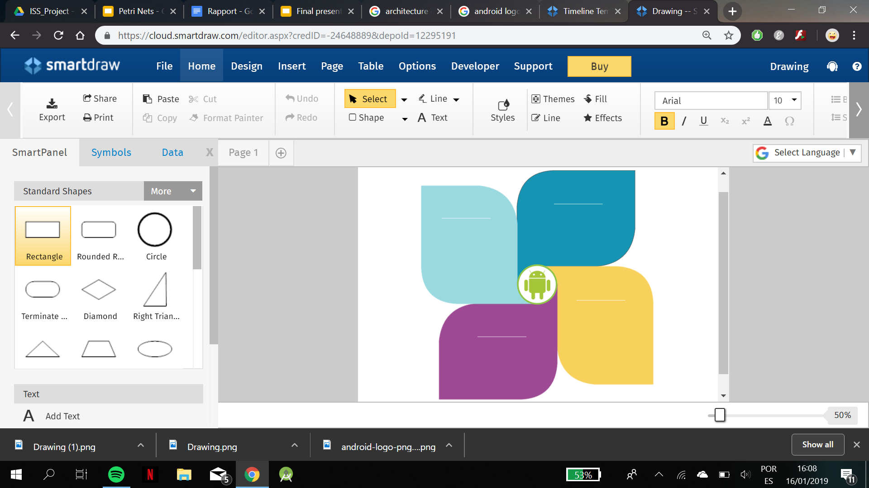

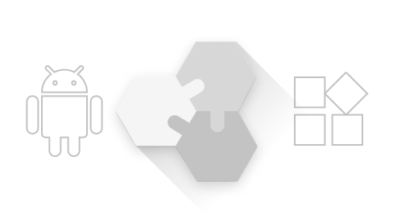


Application
IDE
Architecture
Code
UI Design
‹#›

Slide 16
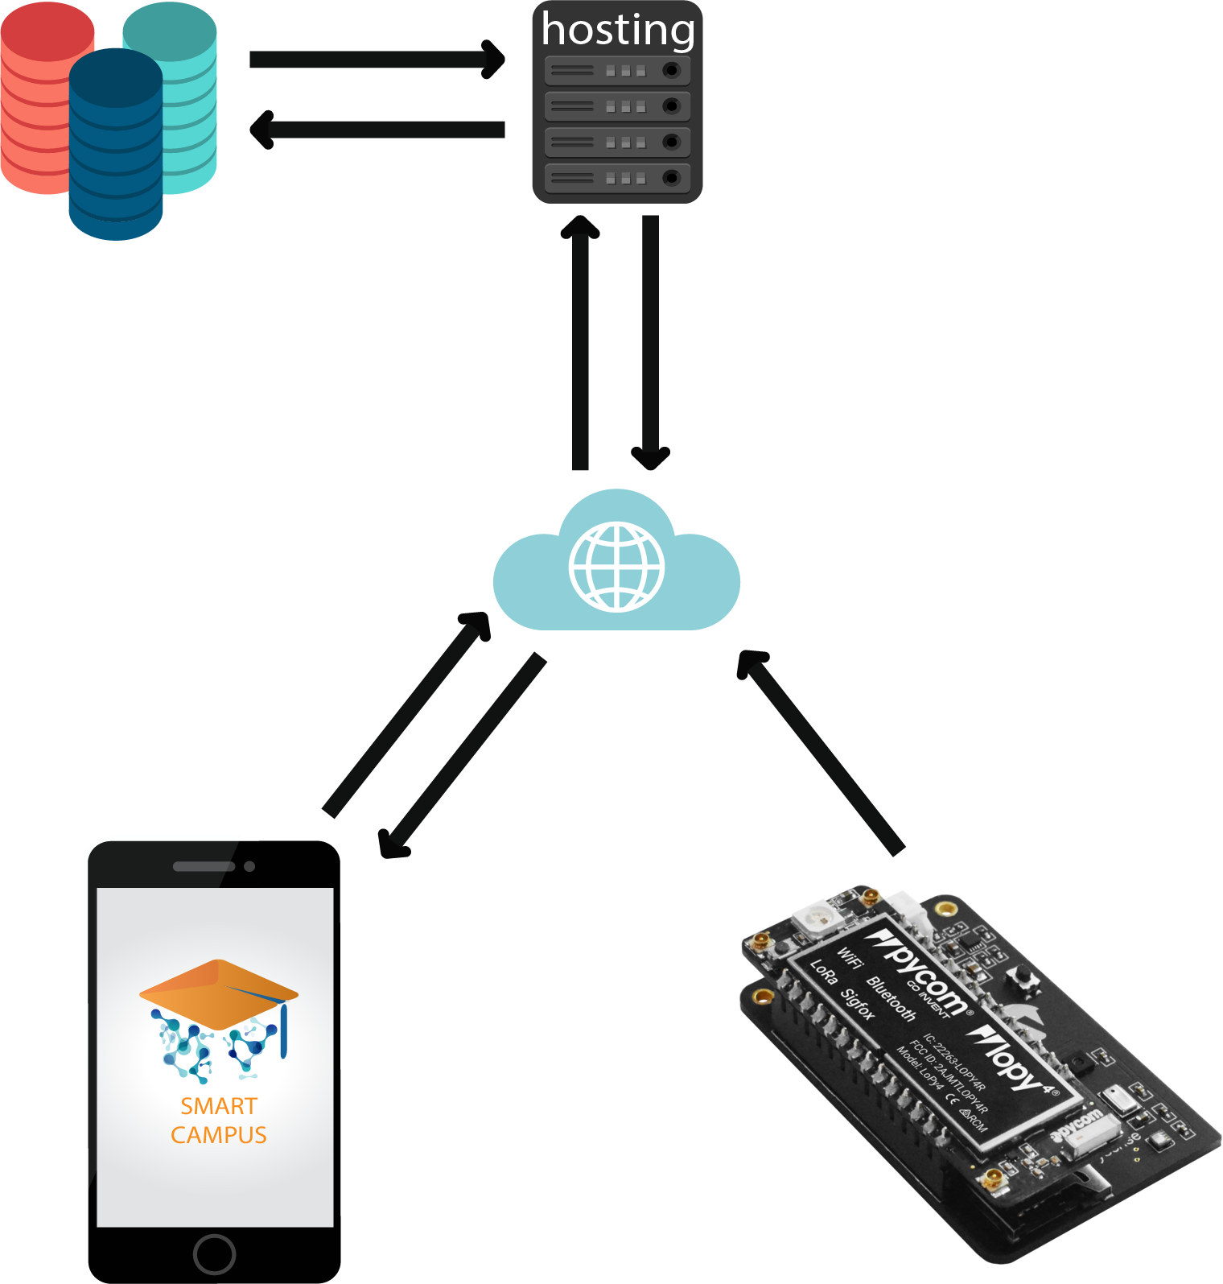
Application
How it works?
Bluetooth Scan
Hash Map
BSSID | RSSI (dBm)
b0:6e:bf:d8:97:fc | -50
... | ...
-45
Wi-Fi Scan
Server Connection
‹#›

Slide 17
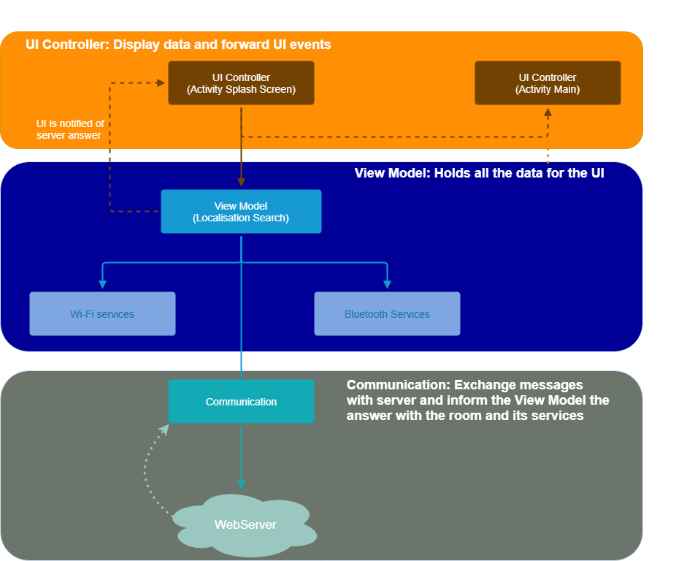
‹#›

Slide 18
Server &
Knowledge Base
Notes:
ATTENTION : Animation !
Going
Comparison of the footprints

Slide 19
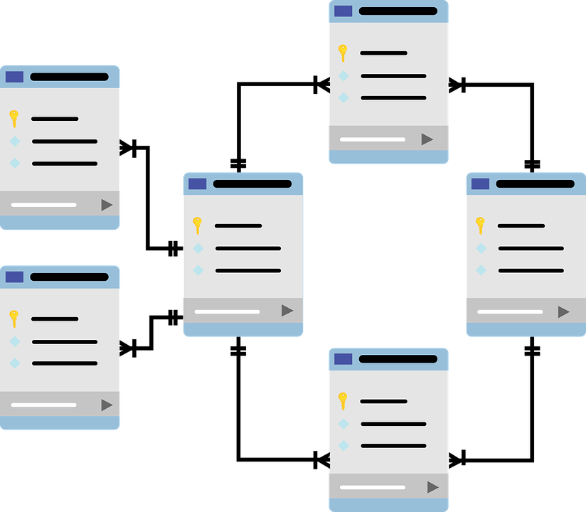
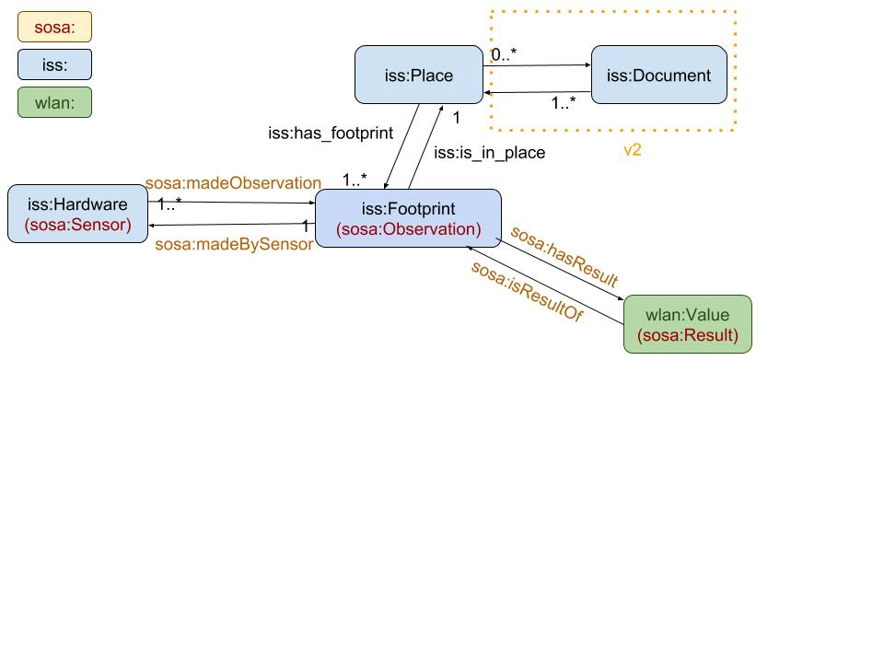
Knowledge Base
Knowledge Base
Traditional database : tables
 |  | 12
age
‹#›
Notes:
Animation
Traditional databases use tables to store data; here is an example, if u only get a valuer of 12, could u tell the meaning of it? No, u can’t. U need to find the corresponding column name. In this case, age is what it represents. Each value is stored separately in the table. And for a complete database, we have many more tables for different kinds of data.
During the developing, if u are not familiar with the database, u have to read through the whole documents to change it.

Slide 20

Knowledge Base
Knowledge Base
Knowledge base : triples
Resource Description Framework
Subject
Predicate
Object
Age
hasValue
12
‹#›
Notes:
Different from traditional databases, knowledge base stores data in the form of triples. This is defined by Resource Description Framework. The data is a self-describe. One triple is composed of a subject, a predicate and a object, where the predicate describes the relationship between subject and object. Taking the same example, the data is a triple this time. And we can easily tell the “12” is a value for “age”.

Slide 21
Knowledge Base
Knowledge Base
Ontology: the concepts and relationships
Semantic Sensor Network Ontology
‹#›
Notes:
Another advantage of using KB is that we can import other ontology into our own. Ontology defines the concepts and relationships. This is our ontology for the project, here we have imported semantic sensor network ontology, which is an ontology for describing sensors and their observations. This can save a lot of time when designing the database, and cover all parts. Also, the data form is easier for people who want to do further research using our data.

Slide 22
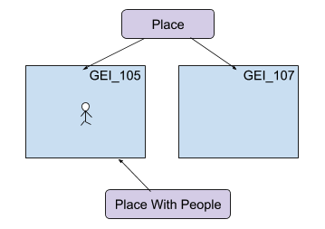

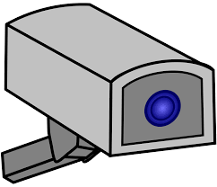

Knowledge Base
Knowledge Base
Reasoner
Rules Deductions
‹#›
Notes:
Animation
Last but not least, in KB u can store rules. With the help of reasoner, we can make deductions on KB. For example, room - Only provide services to ..

Slide 23
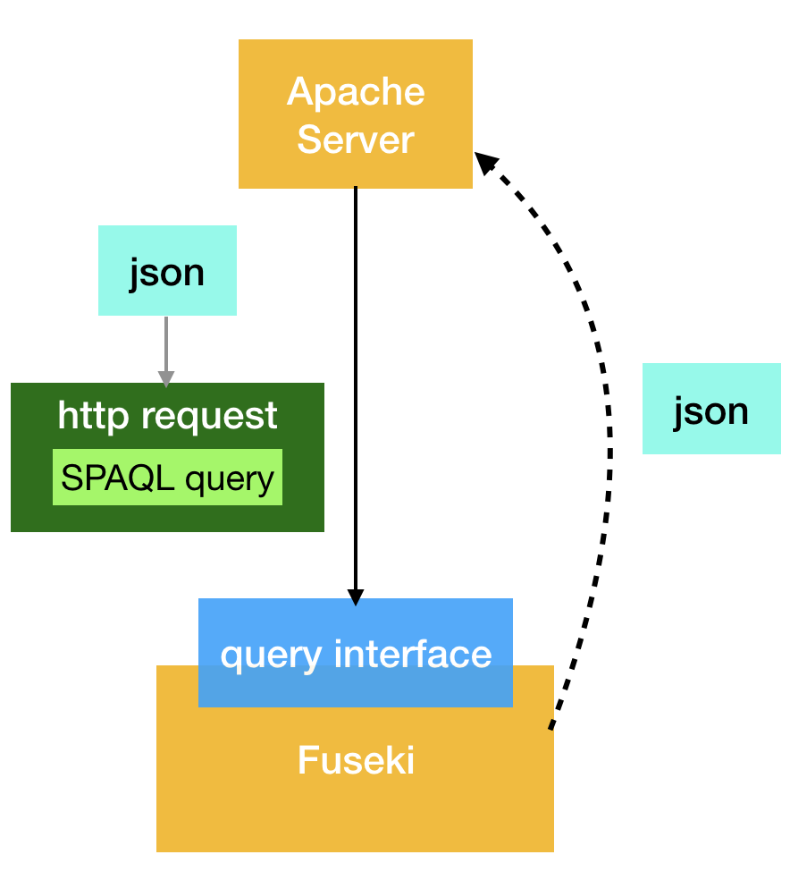
Server & KB
Server & Knowledge Base
‹#›
Notes:
Our server is composed of an apache server to make calculations and a Fuseki server to store data in the knowledge base.Thanks to its query interface, we can easily make http requests in order to communicate between them

Slide 24
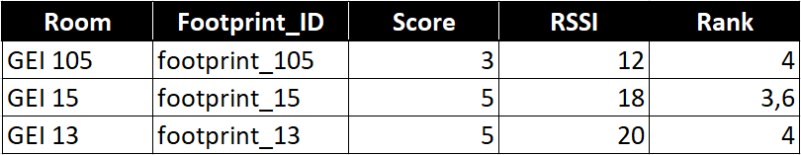
Server & KB
Server & Knowledge Base
From Smartphone
From Knowledge Base
Hash Map
BSSID | RSSI (dBm)
b0:6e:bf:d8:97:fc | -50
... | ...
has_footprint
has_value
GEI 105
footprint 105
Values
has_footprint
has_value
GEI 15
footprint 15
Values
‹#›
Notes:
To make the computation in order to locate users, the smartphone send a list of its environment to the server. The server retrieve rooms that he might be in and assign score depending on which networks they have in commons, it also compute a RSSI that is the difference of RSSI between each networks. Then he compute a rank that is the division of RSSI over the score and take the better one to determine the room.

Slide 25
Results

Slide 26
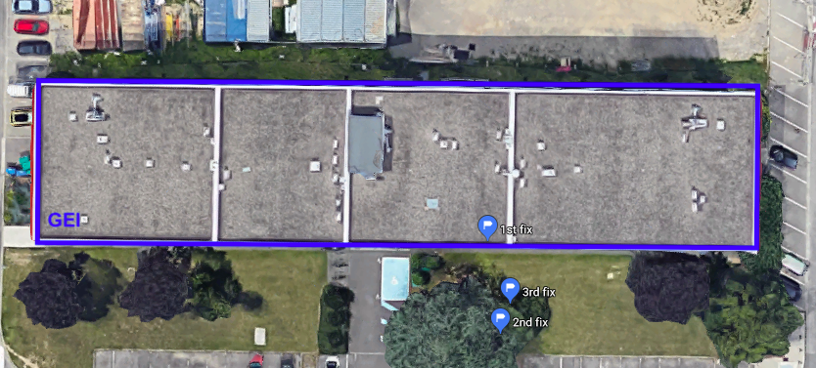
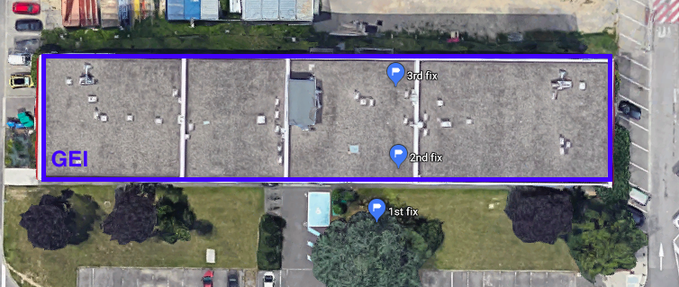
What about
GPS?
GEI 109
GEI 213
‹#›

Slide 27
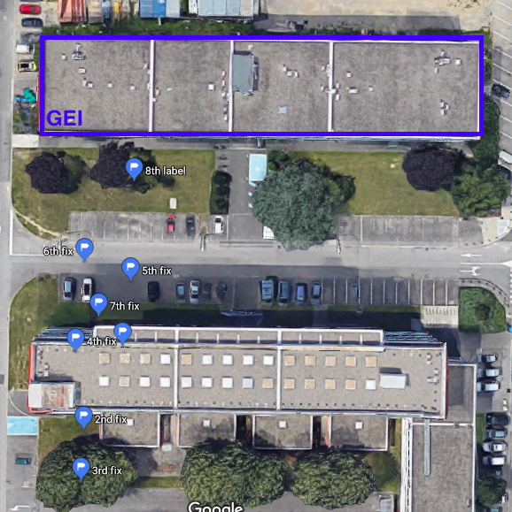
What about
GPS?
GEI 15
‹#›

Slide 28
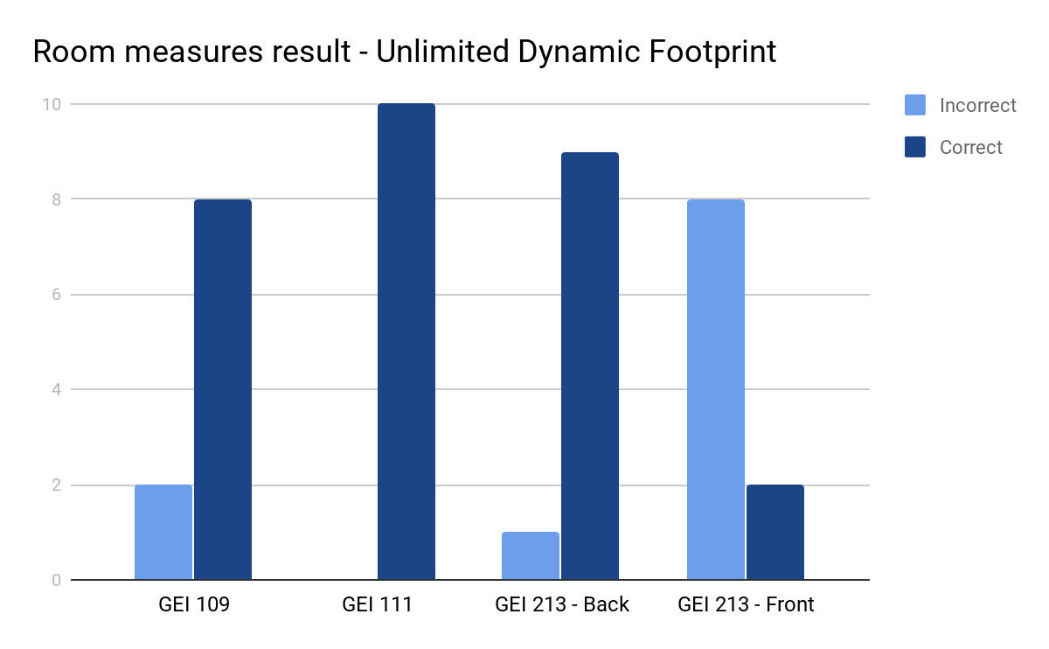
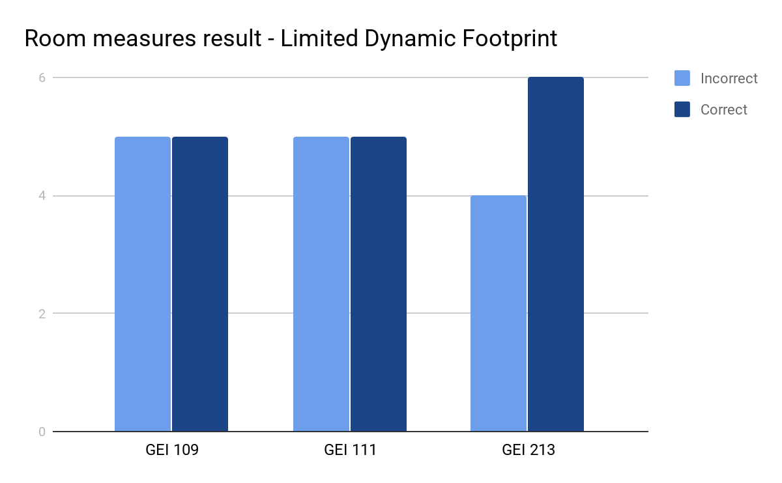
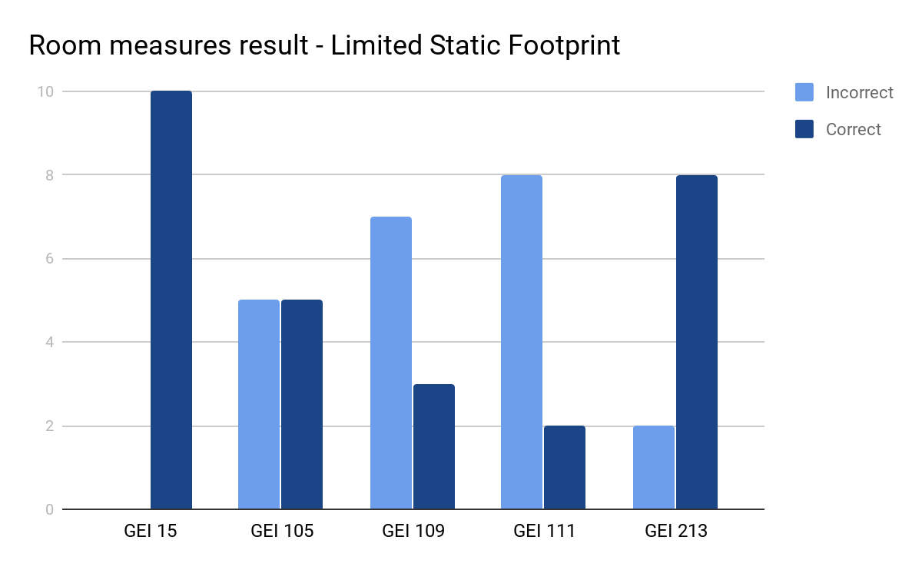
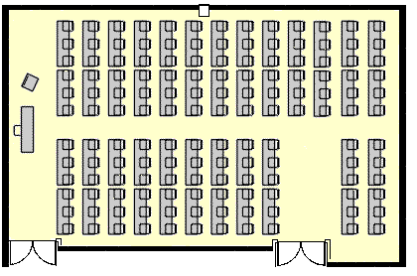



Results
Static x Dynamic footprint
‹#›

Slide 29
Team Work

Slide 30
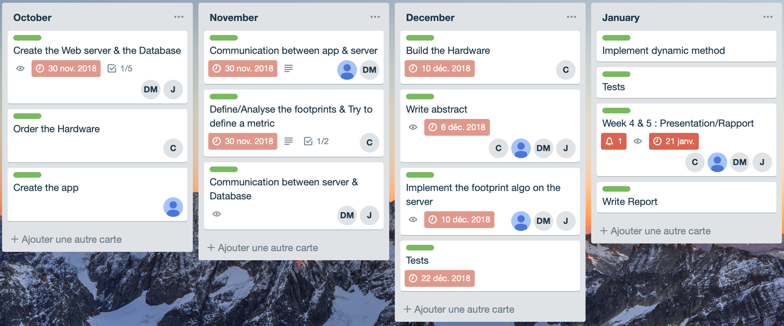
Team work
Trello
‹#›
Notes:
This is the first version of our planning.
Nov, web server, database, app - test with “fake data” We moved the tests to jan
Didn’t get hardware until end of Dec.
Jan, report and presentation, rather satisfying result
Although, we made the planning During our project, we adjusted our planning due to the
I will let Dorian to tell u about our future works.

Slide 31
Future Works

Slide 32
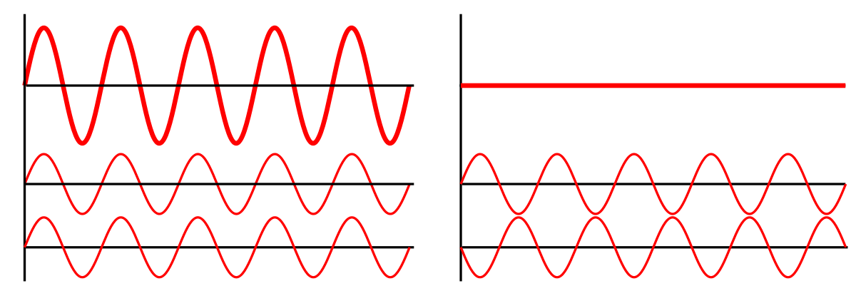

Future works
‹#›
Notes:
The mains problem that we have is scans. Due to many devices, waves can enter in collision and be a constructive or destructive wave and make computation of the localisation wrong. We tried to decrease this effect by taking multiple scan to make the average but there is still an issue with the smartphone, we can’t take more than 4 scans per 2 mins because of a peak consumption of the battery during a scan.

Slide 33



Future works
‹#›
Notes:
What we plan to do is to add others networks to our footprint, the more networks we got, the more accurate our solution is
For now, our solution offers only one service, the one that we presented you but If we want to add more specific services, for example, have access to administration building, we will need to identify the users to give him access, this will lead to the storage of private data.
-Due to this storage, we will also need to ensure security in order to prevent leaks of their private data
We saw that our localisation system is working well, but we can still improve the accuracy and the quality of the services offered.
So we will be happy to discuss with you about possible improvements. Thank you for your attention and feel free to ask us if you have any questions.

Slide 34

Questions?

